Slide 1
Performance Tips for container applications
How to test and check performance issues

Slide 2
Schedule
Infrastructure and Application
What look?
How to look?
Optimization tradeoffs

Slide 3
Infrastructure - Concerns
Isolated
One container application doesn’t affect other
You don’t need to worry about where your container will run
You can reproduce the same behavior locally
Notes:
This are advantages of using containers .But it is not true.
Because depend of how your infrastructure works one application will affect other that shares the same resources.

Slide 4
Infrastructure - Concerns
Your application will share resources with other containers?
Pros
Better use of your physical resources (CPU, Memory, etc)
Your application it is not using CPU ALL the time
Make sense have more than one container in the same host
Save money
Cons
The physical resources available changes over time
Application impacts each other
Spent more money
Notes:
When your containters are in the same machine and you know how it is you can have a better tunning in the application.
But you can spent resources if you not use all potential of your hardware

Slide 5
Infrastructure - Concerns
All containers in the same host are yours?
If yes
The control about sharing resources belongs to the team responsible by the applications
The development team needs to know about infrastructure
The development team could tune the applications and hardware
Could have waste of resources (Ex: batch operations)
If not
The control about sharing resources belongs to the infrastructure team
The development team has fewer options to tune application
Possible no waste of resources
Notes:
When your containters are in the same machine and you know how it is you can have a better tunning in the application.
But you can spent resources if you not use all potential of your hardware

Slide 6
Infrastructure - Concerns
The host will share containers with other applications?
Data base
Infrastructure resources
Load Balancers
HAProxy
Nginx / Apache
Cache Layer
Logger App (ex: FluentD)
Notes:
Depends in how your infrastructure solution using containers are defined you will have in the same machine some applications to everything work.

Slide 7
Infrastructure - Concerns
The environment will put some limits?
Memory
CPU usage
File Descriptor
Network Bandwidth
Disk I/O operations
Notes:
The environment can put some limits. This limits could be from your cloud provider, or if the machines are shared by others applications (or belongs to an infrastructure team) probably will have limits.

Slide 8
Application - Concerns
Your application will run inside a Virtual Machine / Server ?
Java with JVM (Application Server: Tomcat, Jetty, etc)
.NET Kestrel Web Server
Your container runs more than one application?
Notes:
The answer to these questions it's important because your JVM / Server can pre-allocate memory and you could think that your application is using a lot of memory but, your server is allocating and your application is not using at all.
Memory it is an example but other resources could be considering.
If your container has more than one application (ex: aggregator of log) or cache layer. They are sharing resources inside the container (like a virtual machine).

Slide 9
What look?
Memory
CPU usage
File Descriptor
Sockets
Files
Network Bandwidth
Disk I/O operations
Notes:
The answer to these questions it's important because your JVM / Server can pre-allocate memory and you could think that your application is using a lot of memory but, your server is allocating and your application is not using at all.
Memory it is an example but other resources could be considering.

Slide 10
How to look? - Docker run command
docker run -it --ulimit nofile=<file_descriptor_limit> --memory <memory_limit> --cpus <cpu_limit> --name <app_name> <app_image>
Hardware/Infrastructure Limits:
<file_descriptor_limit>
<memory_limit>
<cpu_limit>

Slide 11
How to look? - Minimum requirements
Run your application without limits
Performance Test with status URL (do nothing)
Performance Test with service URL (do the thing)

Slide 12
How to look? - Example
Java Application
Endpoints
GET /status : do nothing, return HTTP 200
POST /sort : Sort N lists of integer numbers internally using async for each list and with thread sleep with random milliseconds

Slide 13
How to look? - Example
curl -v -X POST http://localhost:8080/sort 'content-type: application/json' \ -d '{ "intList": [{ "list": [8, 9, 4, 12, 56, 78, 90, 56, 34, 74] }, { "list": [8, 9, 4, 12, 56, 78, 90, 56, 34, 74] }, { "list": [8, 9, 4, 12, 56, 78, 90, 56, 34, 74] }, { "list": [8, 9, 4, 12, 56, 78, 90, 56, 34, 74] }, { "list": [8, 9, 4, 12, 56, 78, 90, 56, 34, 74] }] }'

Slide 14
How to look? - Example
Run Application
docker run -it -p 8080:8080 --name demo demo:1.0.0
Docker Status
docker stats demo
Open File Descriptors
docker exec -it demo /bin/bash
apt-get update
apt-get install procps -y
ps -efl
watch ‘ls -altr /proc/6/fd | wc -l’

Slide 15
How to look? - Example
Performance Test (Ex: Apache Benchmark Tool)
ab -s 60 -c 10 -n 20 http://localhost:8080/status
-c : Concurrent Users
-n : Number of iterations
-s : timeout (seconds)

Slide 16
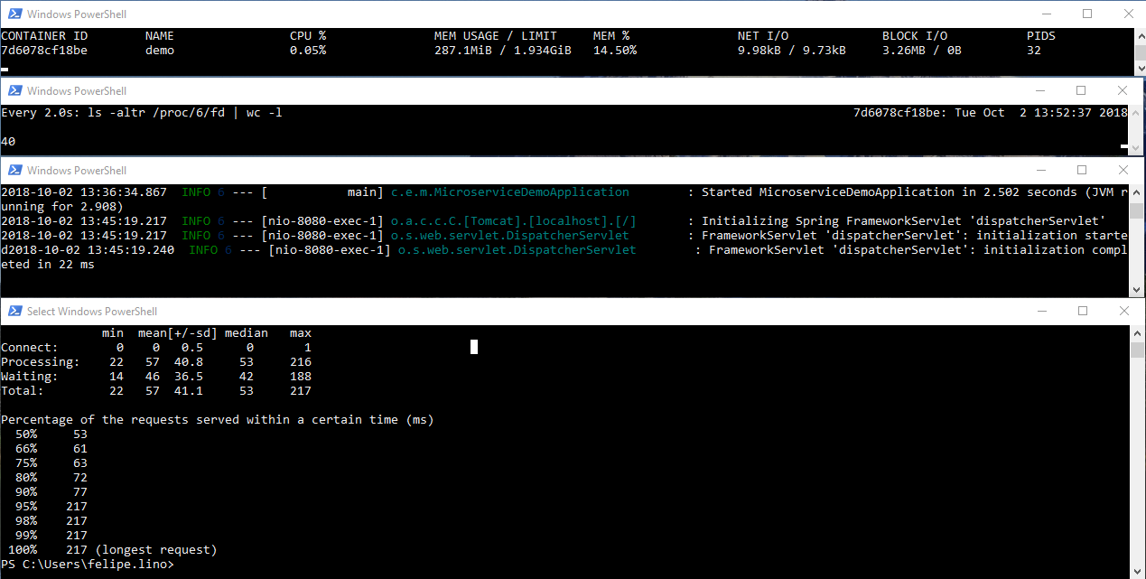
How to look? - Example
Notes:
Check if you not set any limits your application will use all available.
We don’t set any limits for VM too.
Just to run the app we need around 300 MB of memory

Slide 17
How to look? - Example
Performance Test (Ex: Apache Benchmark Tool)
ab -p request.json -T application/json -H 'accept: application/json' -c 10 -n 200 http://localhost:8080/sort

Slide 18
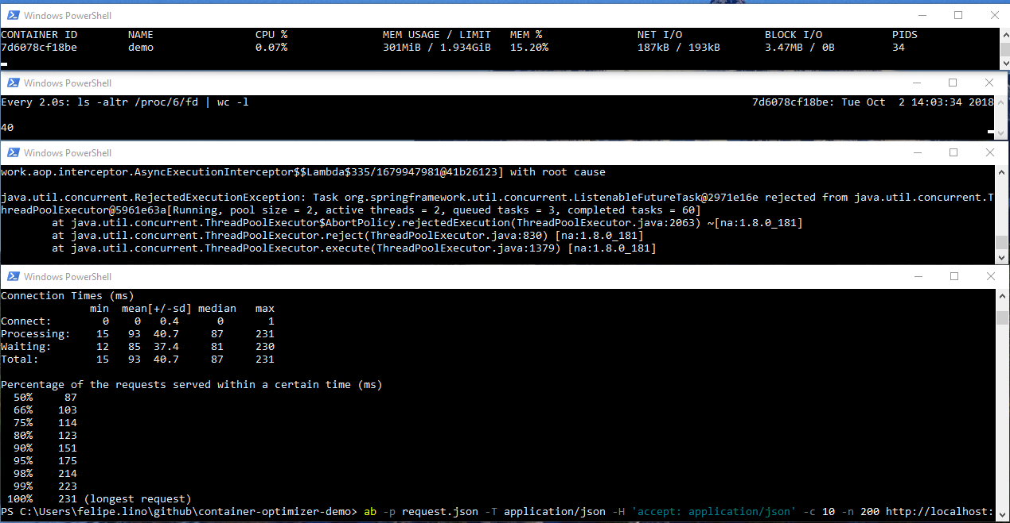
Notes:
Running the app with real data we use a little more memory.
With load the app starts to fail returning HTTP 500 because don’t have enough threads to handle requests

Slide 19
How to look? - Maximum requirements
Run your application applying infrastructure limits
Run your application applying server (JVM) parameters
Performance Test with service URL (do the thing)

Slide 20
How to look? - Example
Run Application
docker run -it --ulimit nofile=128 --memory 1000MB --cpus 0.5 -e "JAVA_OPTS=-Xms312m -Xmx750m -DcorePoolSize=100 -DmaxPoolSize=120 -DqueueCapacity=300" -p 8080:8080 --name demo demo:1.0.0
Infrastructure limits:
--cpus
--memory
--ulimit
Applications config:
Threads: corePoolSize (2), maxPoolSize (2), queueCapacity(3)
Xms / Xmx
etc.
Notes:
Some constraints could be from your infrastructure and other you will define as developer (application config)

Slide 21
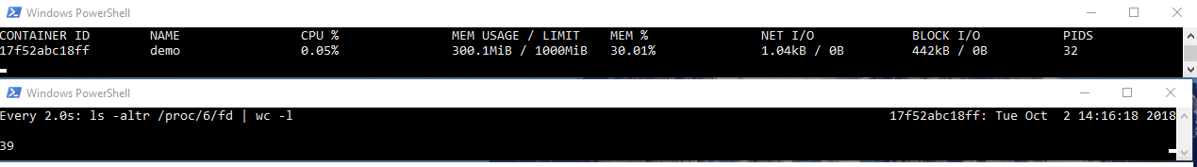
How to look? Before start again
Memory Limit is 1GB
You start to usage around 300MB because of JAVA_OPTS with -Xms312m

Slide 22
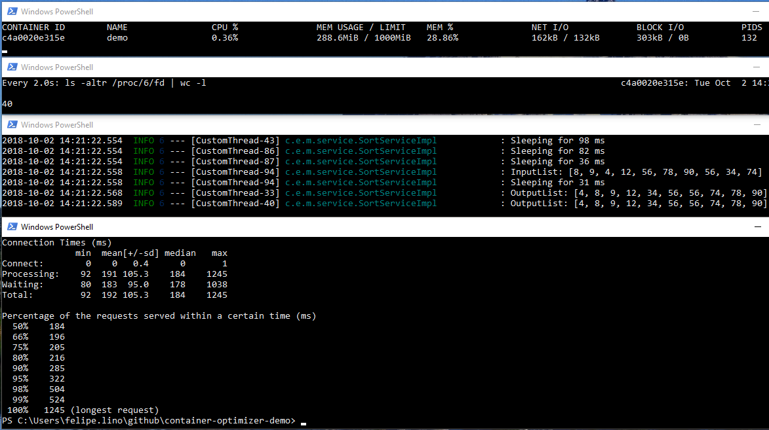
Notes:
If you compare the results is worse. Because the average here is around 192ms in the previou scenario you have 93ms
BUT here ALL requests are SUCCESSFUL and Before you have a LOT of FAILURES
It is a tradeoff sometimes is better return FAIL fast than return success spending more time
AB (Apache Benchmark Tool) to evaluate the result of HTTP code. Other tools like Gatling does. It is important have this metric too.
You can combine this metric with Newrelic or other APM tool.

Slide 23
Optimizations tradeoffs
Change memory limits
Change CPU limits
File Descriptors and Sockets
Number of containers x Threads (workers) inside application
Specific configurations for your Server/JVM
server.undertow.io-threads
KestrelServerOptions.ThreadCount
Notes:
Memory Limits: If you look about usage of your application you can verify if you really need the amount of memory reserved. In this case if the worse input of my application is that JSON you can change from 1GB to around 500MB.
CPU Limits: In this case we change from --cpus 1.0 to 0.5 . If you have an application that do a lot of I/O and you are running multiple containers make sense reduce the ‘amount of processors’ . But if your application is CPU bound you can reserve ‘more’ CPU
File Descriptors and Sockets: some drivers (cassandra driver for example) creates sockets to do async queries, each socket creates file descriptors. The host has a limit and the sum of each container should be less than the host limit.
Threads: for this application answer correctly we need to increase the number of threads. Sometimes when you increase the number of threads you increase the amount of sockets too. We can increase the number of application instances instead of increase the number of threads inside the application. We need to balance what is better case a case.
As example you have to set good values for your specific application configuration. A little bit about Tomcat Undertow the io-threads (for default) dinamically assumes CPU divide by 2, but JVM check the physical CPU , so if you have a big machine (Ex: 12 cores) that runs some containers by default io-threads will be 6 and this is a problem when you are in a shared environment.

Slide 24
Optimizations tradeoffs
IO Usage
Network Usage
Related dependencies
APIs
Database
File System
Notes:
This example don’t access external dependencies, you should consider what kind of file system you are using (some cloud providers has limits in IOPs)
And check bottlenecks like other APIs, Database, etc.

Slide 25

Any doubts?
Source:
https://github.com/felipelino/container-optimizer-demo
Contacts:
Felipe Lino (felipelino44@gmail.com)

